Slide 1
Digital Image Processing
软件：MatLab,SCILAB
Image Enhancement
图像增强
(Histogram Processing)
直方图处理

Slide 2
Contents
内容
Over the next few lectures we will look at image enhancement techniques working in the spatial domain:
  What is image enhancement?
  Different kinds of image enhancement
  Histogram processing
  Point processing
  Neighbourhood operations

Slide 3
A Note About Grey Levels
灰度说明
So far when we have spoken about image grey level values we have said they are in the range [0, 255]
  Where 0 is black and 255 is white
There is no reason why we have to use this range
  The range [0,255] stems from display technologes
For many of the image processing operations in this lecture grey levels are assumed to be given in the range [0.0, 1.0]

Slide 4
What Is Image Enhancement?
什么是图像增强？
Image enhancement is the process of making images more useful
The reasons for doing this include:
  Highlighting interesting detail in images
  Removing noise from images
  Making images more visually appealing

Slide 5
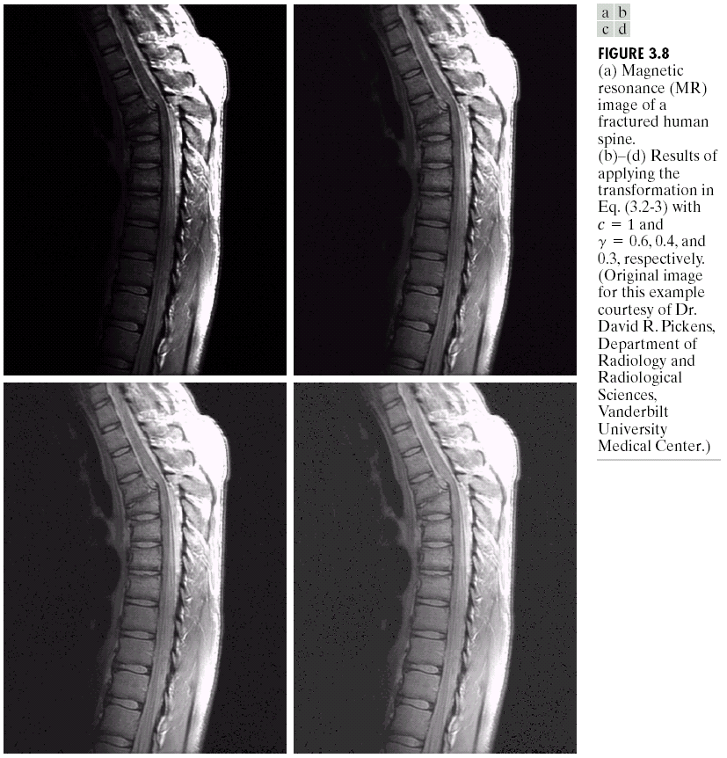

Image Enhancement Examples
例子
Images taken from Gonzalez & Woods, Digital Image Processing (2002)

Slide 6
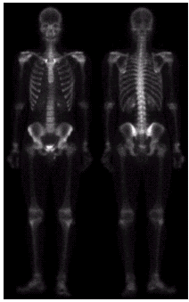
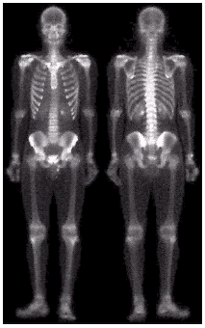
Image Enhancement Examples (cont…)
Images taken from Gonzalez & Woods, Digital Image Processing (2002)

Slide 7

Image Enhancement Examples (cont…)
Images taken from Gonzalez & Woods, Digital Image Processing (2002)

Slide 8
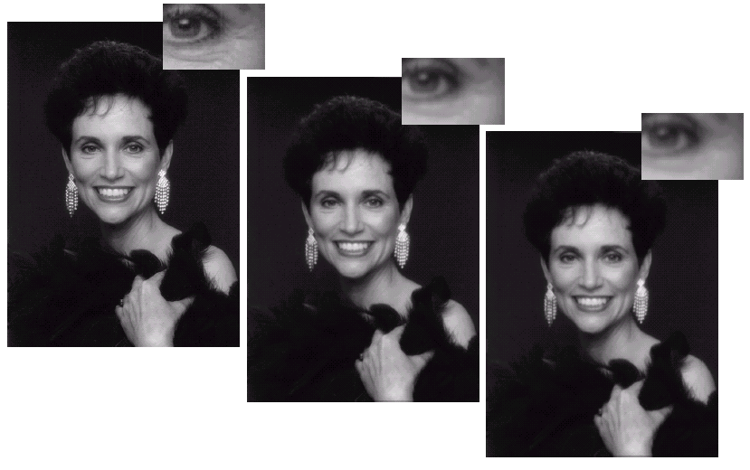
Image Enhancement Examples (cont…)
Images taken from Gonzalez & Woods, Digital Image Processing (2002)

Slide 9
Spatial & Frequency Domains
空间域和频域
There are two broad categories of image enhancement techniques
  Spatial domain techniques
    Direct manipulation of image pixels
  Frequency domain techniques
    Manipulation of Fourier transform or wavelet transform of an image
For the moment we will concentrate on techniques that operate in the spatial domain

Slide 10
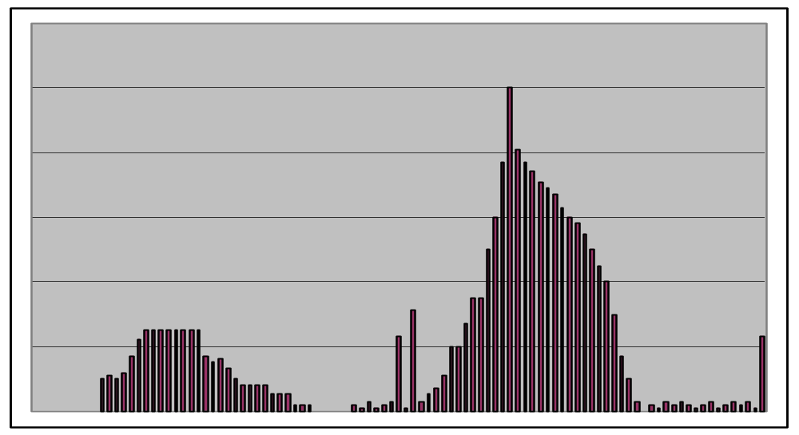
Image Histograms
直方图处理
The histogram of an image shows us the distribution of grey levels in the image
Massively useful in image processing, especially in segmentation
Frequencies
Grey Levels

Slide 11
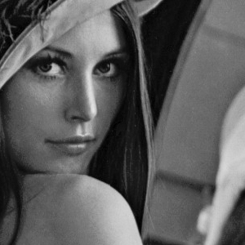
Histogram Examples
Images taken from Gonzalez & Woods, Digital Image Processing (2002)

Slide 12
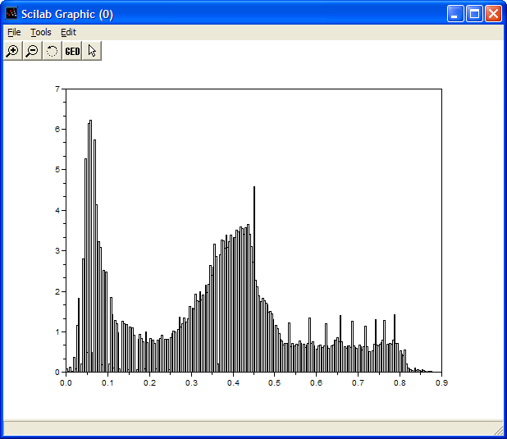
Histogram Examples (cont…)
Images taken from Gonzalez & Woods, Digital Image Processing (2002)

Slide 13
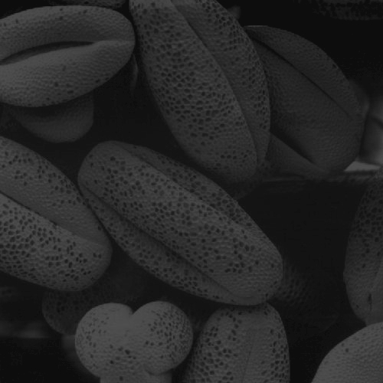
Histogram Examples (cont…)
Images taken from Gonzalez & Woods, Digital Image Processing (2002)

Slide 14
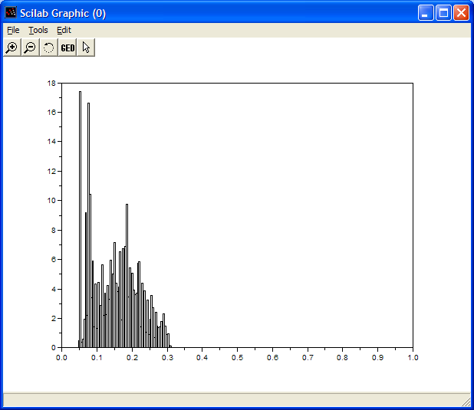
Histogram Examples (cont…)
Images taken from Gonzalez & Woods, Digital Image Processing (2002)

Slide 15
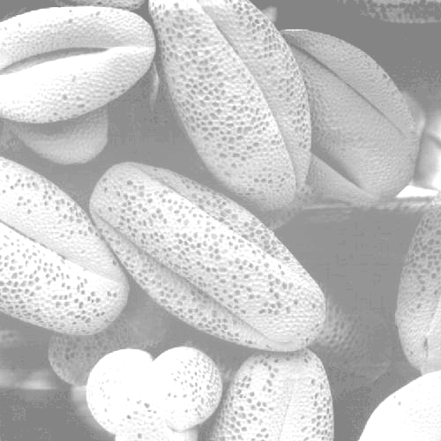
Histogram Examples (cont…)
Images taken from Gonzalez & Woods, Digital Image Processing (2002)

Slide 16
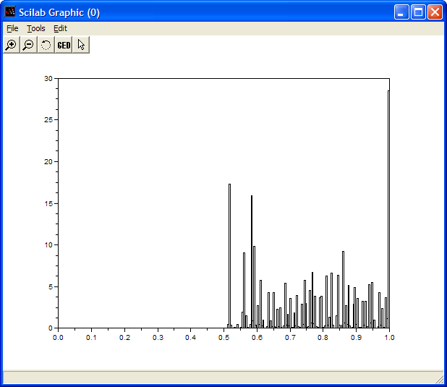
Histogram Examples (cont…)
Images taken from Gonzalez & Woods, Digital Image Processing (2002)

Slide 17

Histogram Examples (cont…)
Images taken from Gonzalez & Woods, Digital Image Processing (2002)

Slide 18
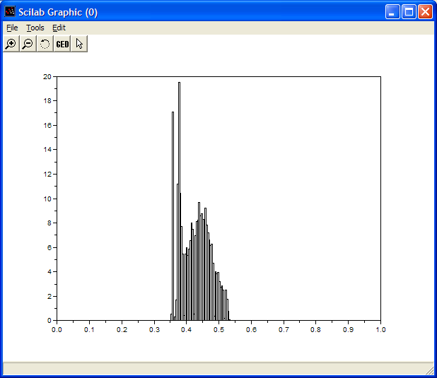
Histogram Examples (cont…)
Images taken from Gonzalez & Woods, Digital Image Processing (2002)

Slide 19
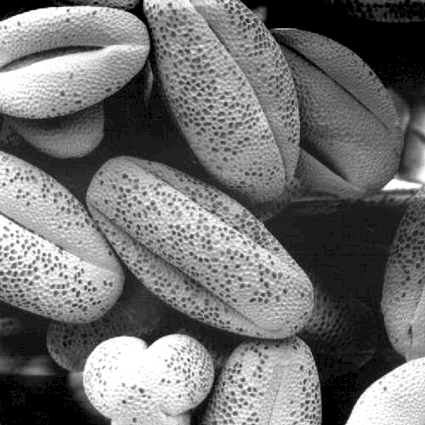
Histogram Examples (cont…)
Images taken from Gonzalez & Woods, Digital Image Processing (2002)

Slide 20
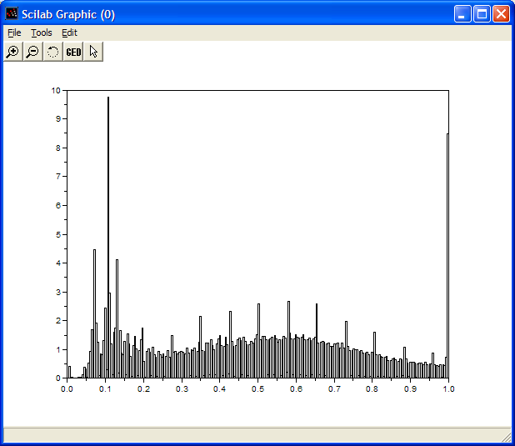
Histogram Examples (cont…)
Images taken from Gonzalez & Woods, Digital Image Processing (2002)

Slide 21
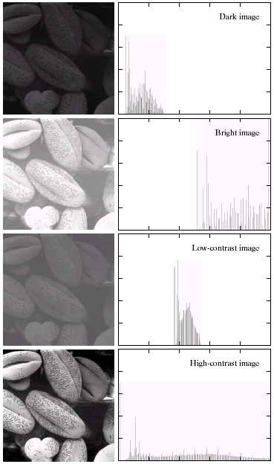
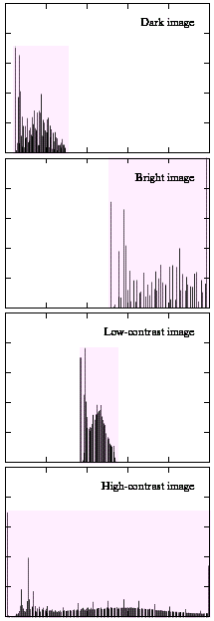
Histogram Examples (cont…)
A selection of images and
their histograms
Notice the relationships
between the images and
their histograms
Note that the high contrast
image has the most
evenly spaced histogram
Images taken from Gonzalez & Woods, Digital Image Processing (2002)

Slide 22
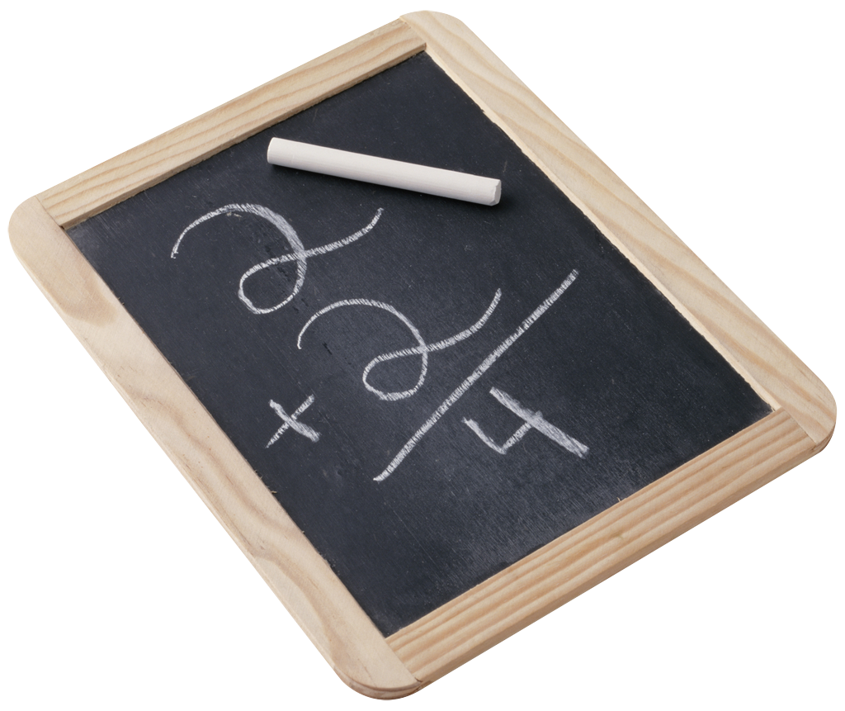
Contrast Stretching
对比度拉伸
We can fix images that have poor contrast by applying a pretty simple contrast specification
The interesting part is how do we decide on this transformation function?

Slide 23
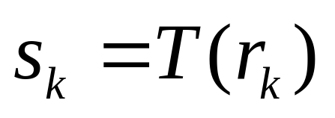
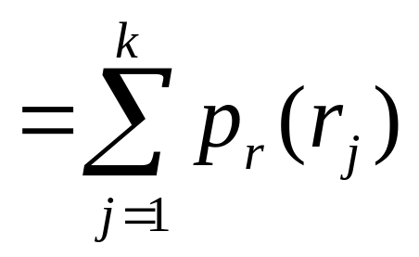
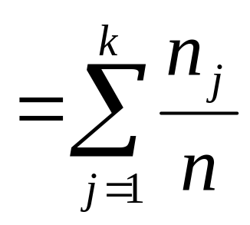
Histogram Equalisation
直方图均衡化
Spreading out the frequencies in an image (or equalising the image) is a simple way to improve dark or washed out images
The formula for histogram
equalisation is given where
  r_{k}: input intensity
  s_{k}: processed intensity
  k: the intensity range
  (e.g 0.0 – 1.0) （0~255）
  n_{j}: the frequency of intensity j
  n: the sum of all frequencies

Slide 24
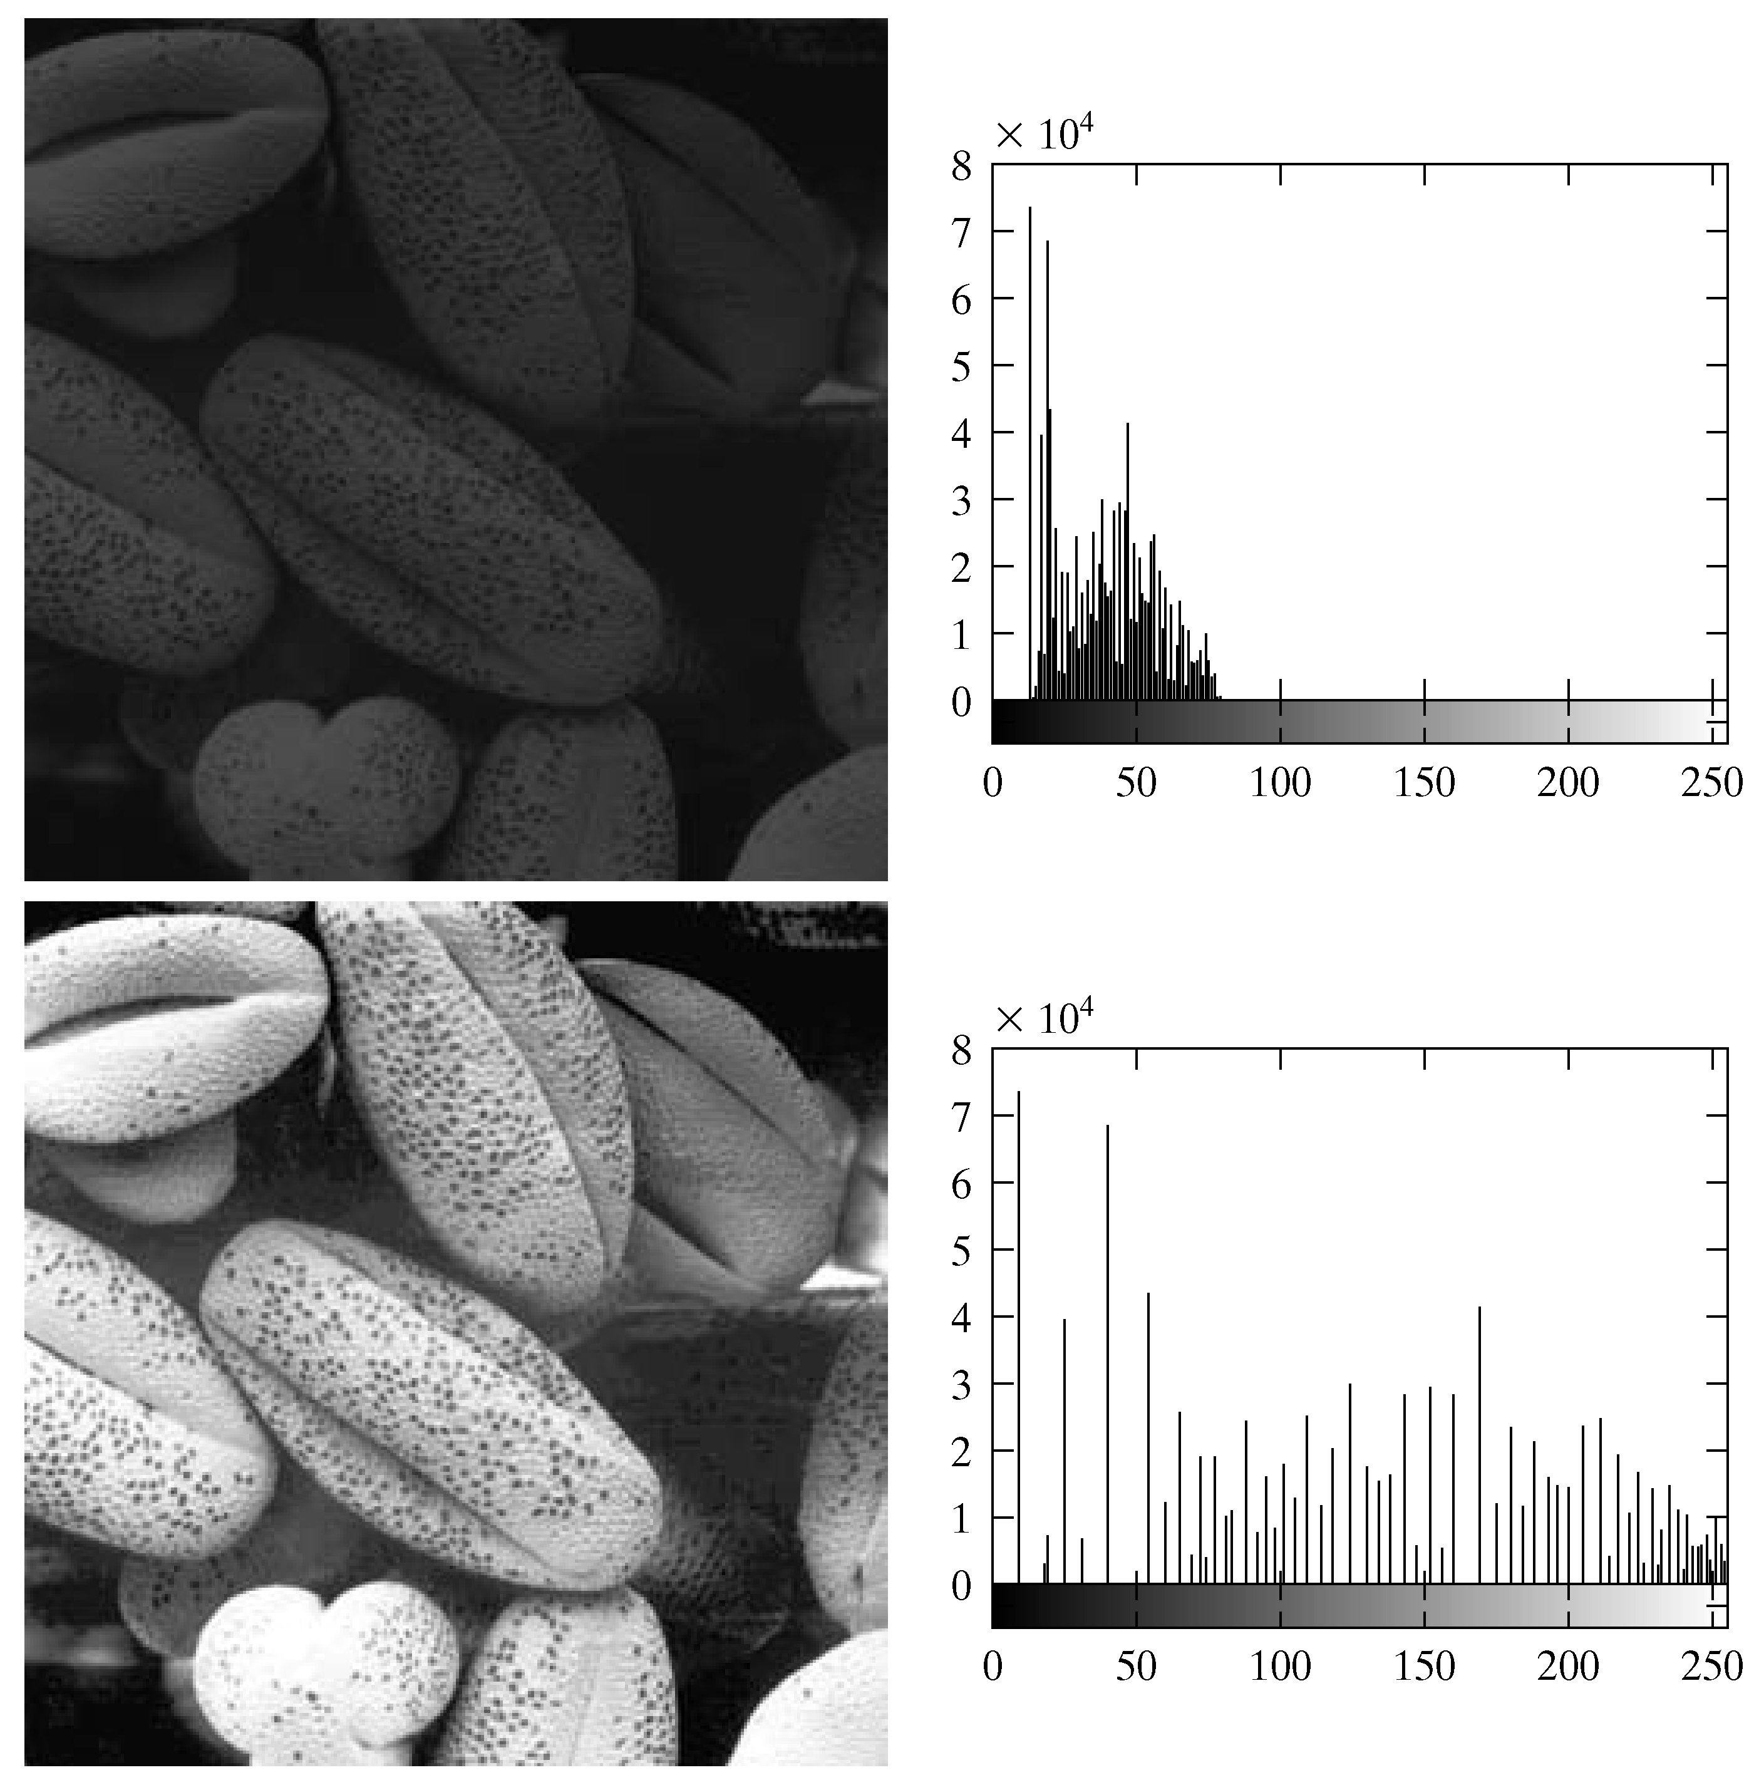
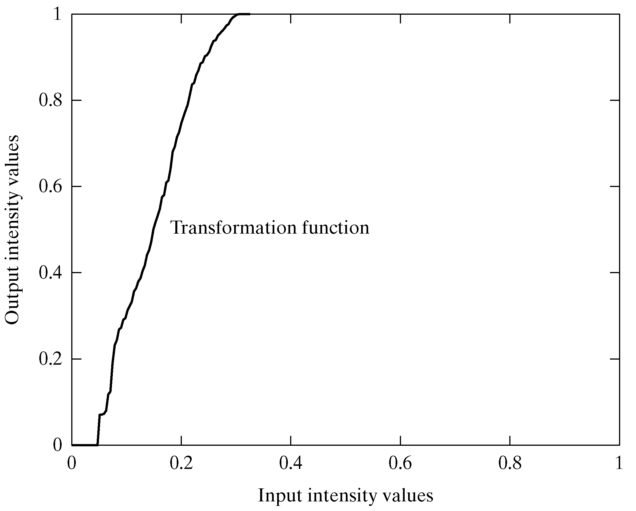
Equalisation Transformation Function
Images taken from Gonzalez & Woods, Digital Image Processing (2002)

Slide 25
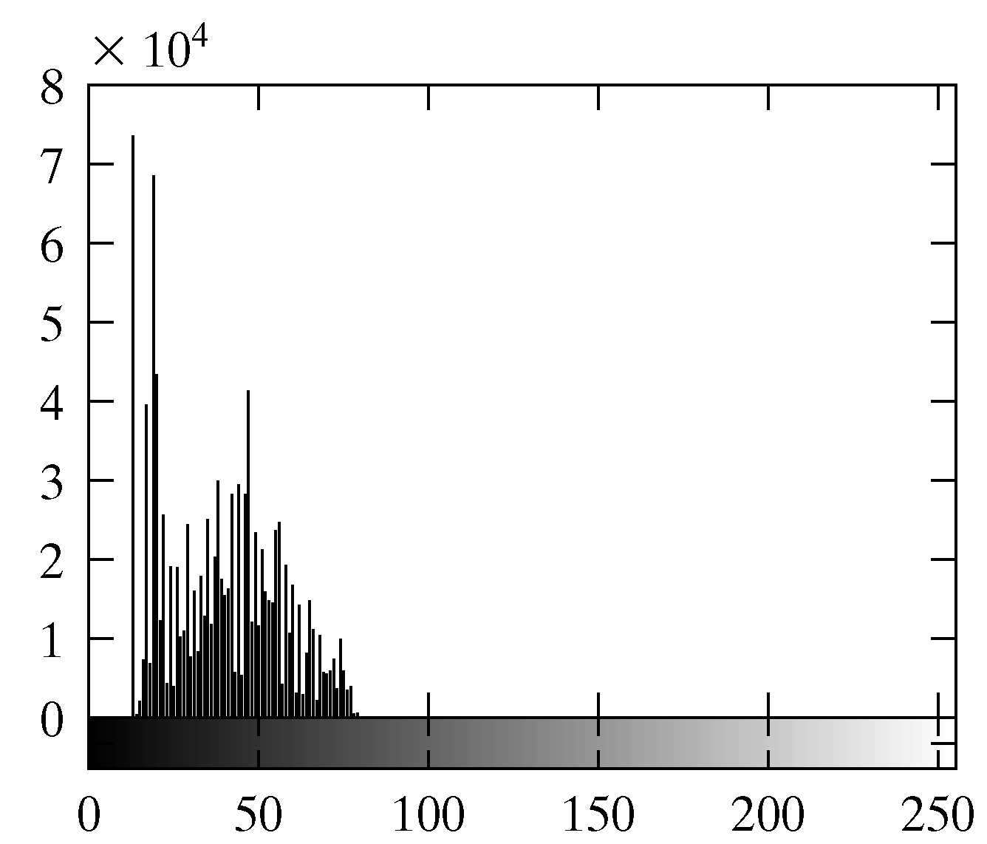
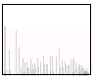
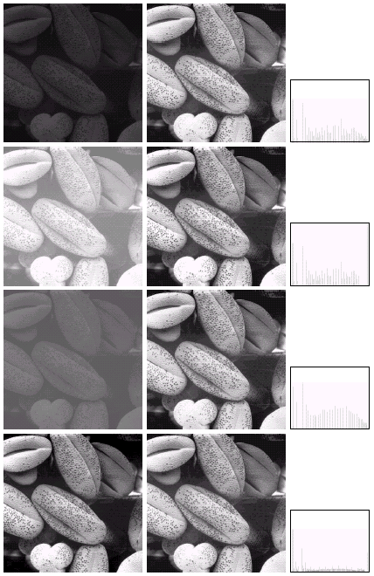
Equalisation Examples
1
Images taken from Gonzalez & Woods, Digital Image Processing (2002)

Slide 26
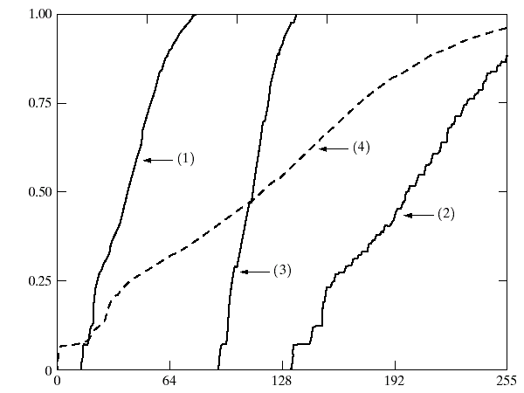
Equalisation Transformation Functions
The functions used to equalise the images in the previous example
Images taken from Gonzalez & Woods, Digital Image Processing (2002)

Slide 27
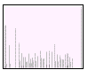
Equalisation Examples
2
Images taken from Gonzalez & Woods, Digital Image Processing (2002)

Slide 28
Equalisation Transformation Functions
The functions used to equalise the images in the previous example
Images taken from Gonzalez & Woods, Digital Image Processing (2002)

Slide 29
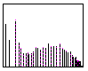
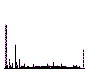
Equalisation Examples (cont…)
3
Images taken from Gonzalez & Woods, Digital Image Processing (2002)
4

Slide 30
Equalisation Examples (cont…)
3
Images taken from Gonzalez & Woods, Digital Image Processing (2002)
4

Slide 31
Equalisation Transformation Functions
The functions used to equalise the images in the previous examples
Images taken from Gonzalez & Woods, Digital Image Processing (2002)

Slide 32
Summary
小结
We have looked at:
  Different kinds of image enhancement
  Histograms
  Histogram equalisation
Next time we will start to look at point processing and some neighbourhood operations

